Slide 1



Slide 2

TEACHER INTRODUCTION
MD. ENAMUL HOQUE
ASSISTANT TEACHER
ID-NO-11
TILAKPUR MUSLIM HIGH SCHOOL
TILAKPUR,NAOGAON SADAR, NAOGAON
MOBILE NO-01718 676169
Email-enamulhoquemd@gmail.com

Slide 3
TODAY’S LESSON
CLASS- NINE
SUBJECT : ENGLISH FIRST PAPER
Unit-5, Lesson-2
Dated-17/02/2014

Slide 4
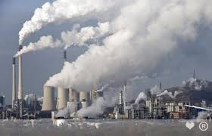
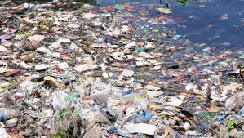
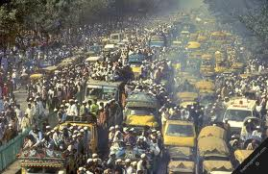
LOOK AT THE PICTURES BELOW AND DISCUSS WITH EACH OTHER
AIR POLLUTION
WATER POLLUTION
SOUND POLLUTION

Slide 5
Today’s topic :
Environmental pollution

Slide 6

1. Ask and answer questions.
2. Understand and narrate problems.
3. Read and comprehend the texts.

Slide 7

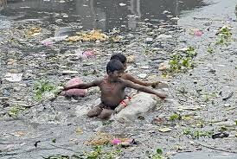
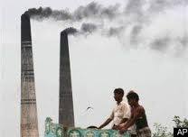
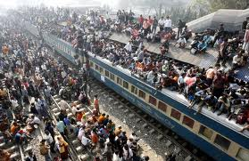
Picture-1
Picture-2
Picture-3
What do you mean by pollution?

Slide 8
Solution of individual work:-
I mean by pollution that create many problem in human body.

Slide 9
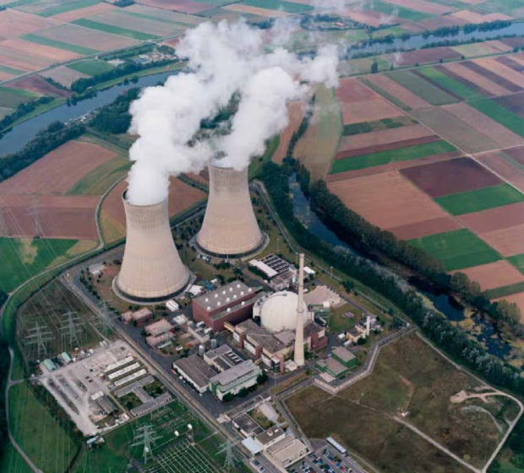
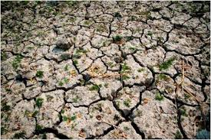
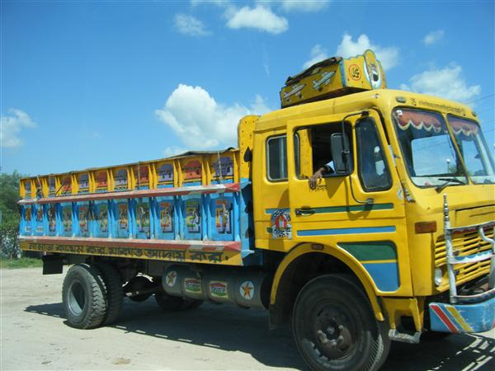
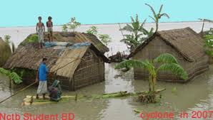
Pair work :
What are some of the common sources of Environmental pollution?

Slide 10
Solution of Pair work :
Some of the common sources of Environment pollution are -
AIR POLLTION
WATER POLLTION
SOIL POLLTION
SOUND POLLTION

Slide 11
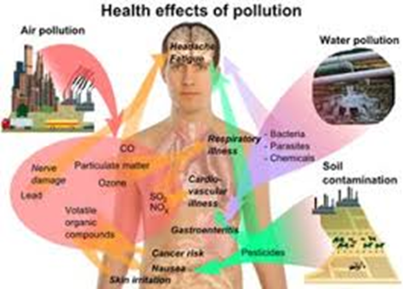
Group work :
Which of the sources are most affecting human for our health ?
Air
Water
Sound

Slide 12
Solution of group work:
More or less all sources are affecting for our health. But I think the most affecting sources for our health are air and sound or soil.

Slide 13

Evaluation:
1. What type of pollution most harm ?
(a) Noise pollution
(b) Air pollution
(c) Soil pollution
(d) Water pollution
√
2. How air is polluted ?
(a) By different reason
(b) By different factories
(c) By water
(d) By different kinds of smoke
√

Slide 14
Home work :
Write a paragraph about “Water pollution’’.

Slide 15



